Slide 1

SUICIDE RATES ANALYSIS
TEAM 8:
NEELIMA PALLEBOINA
KRISHNA REDDY

Slide 2
INTRODUCTION
PUBLIC HEALTH SIGNIFICANCE:
Insight into Complexity : Analyzing suicide rates provides crucial insights into the multifaceted nature of suicide, aiding in comprehension of its intricate causes and contributing factors.
Customized Preventive Measures: This analysis informs the development of targeted and effective preventive measures, tailored to the unique needs and vulnerabilities of specific populations.
High-Risk Population Identification : By identifying high-risk demographics, such as age groups, genders, and socio-economic strata, public health officials can prioritize and tailor interventions.
TARGETED ANALYSIS SCOPE:
Demographic Focus: The analysis goes beyond overall rates, examining specific demographics like sex, race, Hispanic origin, and age, facilitating a nuanced understanding of suicide dynamics.
Temporal Understanding: A temporal analysis helps in recognizing trends and changes in suicide rates over time, critical for adapting interventions to evolving circumstances.
Global Insight: Covering a wide global spectrum, the analysis offers a comprehensive view, enabling the development of strategies adaptable to diverse cultural and socio-economic contexts.

Slide 3
OBJECTIVE
PRIMARY OBJECTIVE:
Conduct a comprehensive analysis of suicide patterns and causes globally.
INSIGHT GENERATION:
Gain critical insights into the primary factors contributing to higher suicide rates.
SOCIO-ECONOMIC ANALYSIS:
Investigate the potential impact of a country's GDP on suicide rates.
REGIONAL AND AGE-SPECIFIC EXPLORATION:
Explore variations in suicide rates across regions and conduct age-specific analyses.

Slide 4
DATASET
The dataset is a comprehensive collection of suicide-related information spanning a significant timeframe, from 1985 to 2016, offering a broad view of global suicide trends.
Each row in the dataset represents a unique instance, providing details about suicides in various countries across different years.
Beyond capturing the raw numbers of suicides, the dataset includes additional information, such as population figures, GDP metrics, and demographic categorizations like age and gender.
The dataset comprises 11 columns and 27,821 rows, organized in alphabetical order of countries.

Slide 5
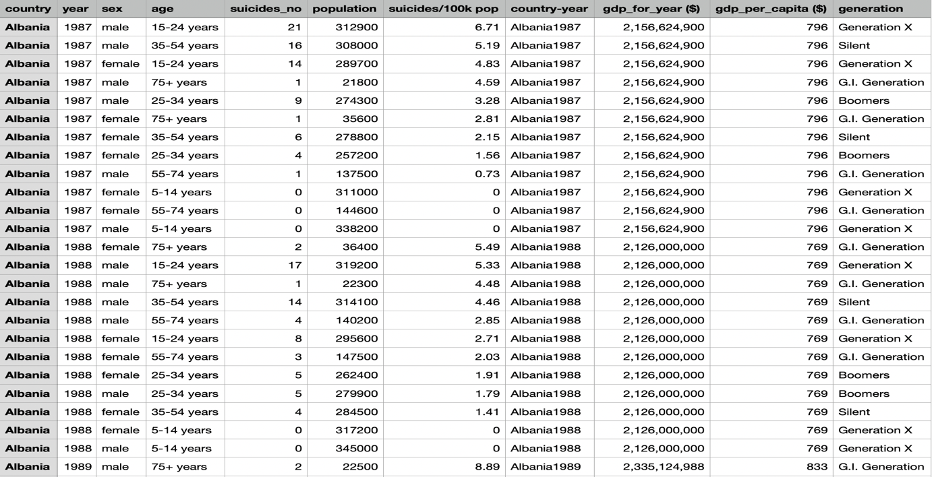
DATASET

Slide 6
WORKING SYSTEM
FRAMEWORK OF PROPOSED SYSYEM:
The envisioned system structure involves data preprocessing and cleaning, data ingestion and storage, as well as data processing and transformation for analyzing suicide rates globally.
Employing big data technologies and machine learning, the system aims to improve the analysis of suicide rates.
DATA ANALYSIS APPROACH:
We imputed the missing values specifically in the 'HDI for year' column . We eliminated the duplicate values that are present in the dataset.
Conducted EDA using distribution analysis, correlation matrices, and geospatial visualizations.
Focused on understanding suicide rates by gender, age, and region, identifying key trends and patterns.
Applied regression models (linear and random forest) to predict suicide rates and reveal significant predictors.
Utilized classification models (logistic regression and decision trees) for country classification based on suicide rate classes.
Explored time series forecasting for predicting future suicide rates.
Applied clustering algorithms to group countries with similar suicide rate trends, providing insights into global patterns.
robustness.

Slide 7
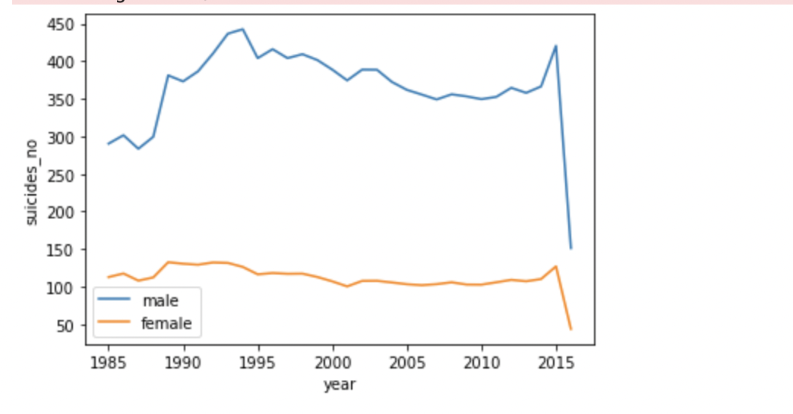
RESULTS AND ANALYSIS
This shows that suicide rate is more in males compared to females in all the years from 1985 to 2016

Slide 8
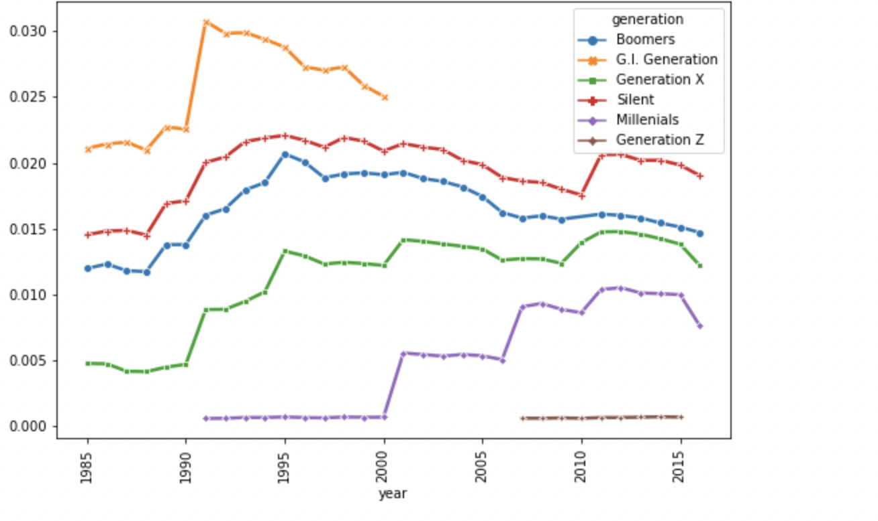
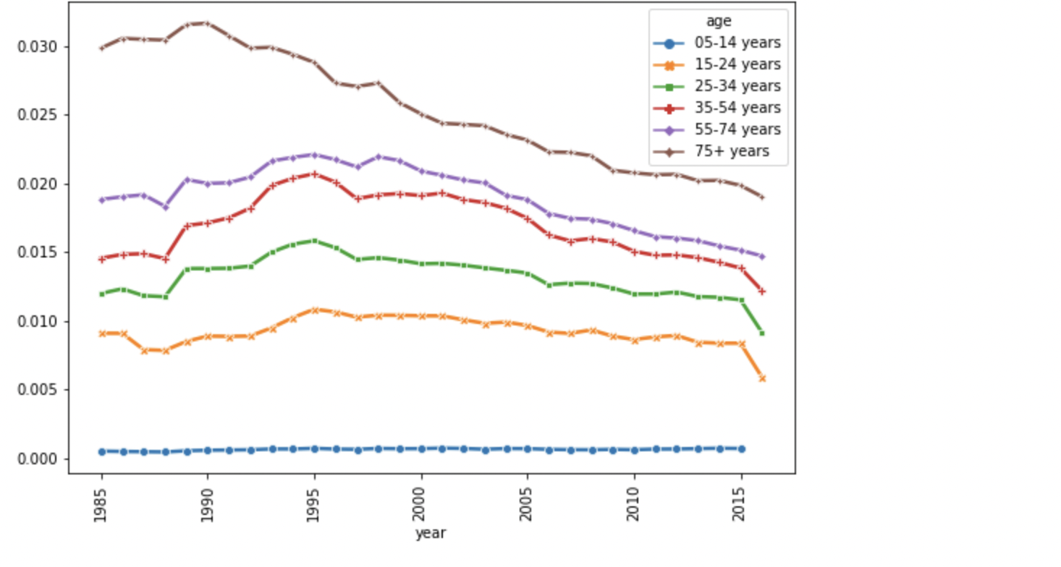
SUICIDE RATES IN ALL AGES

Slide 9
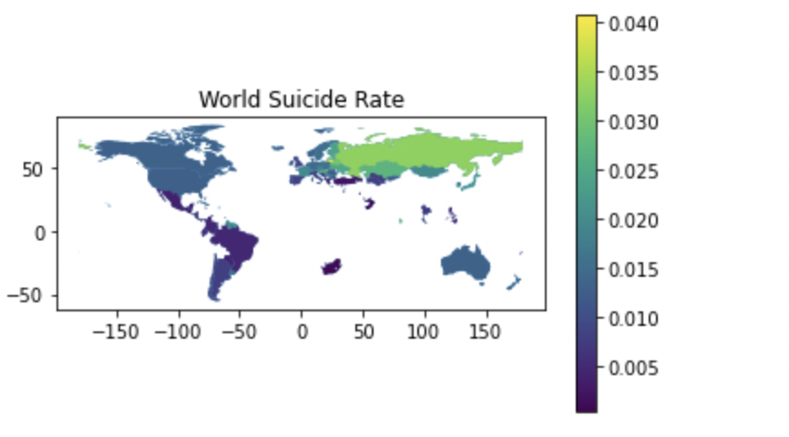
GEOPOLITICAL ANALYSIS

Slide 10
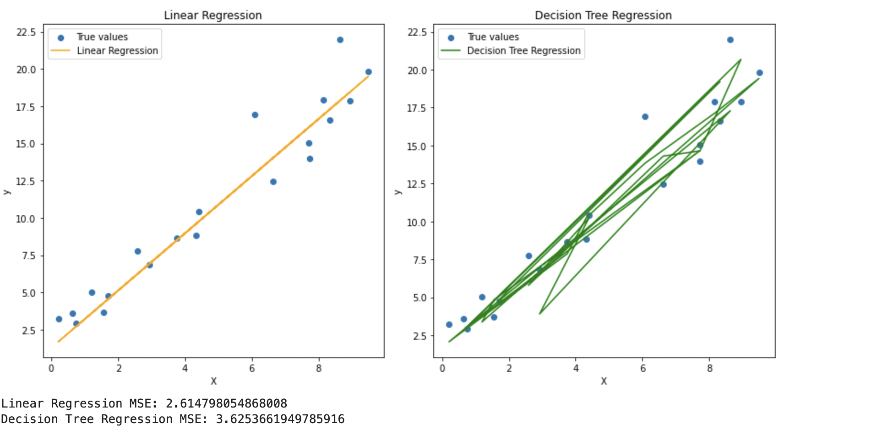
LINEAR REGRESSION AND DECISION TREE

Slide 11
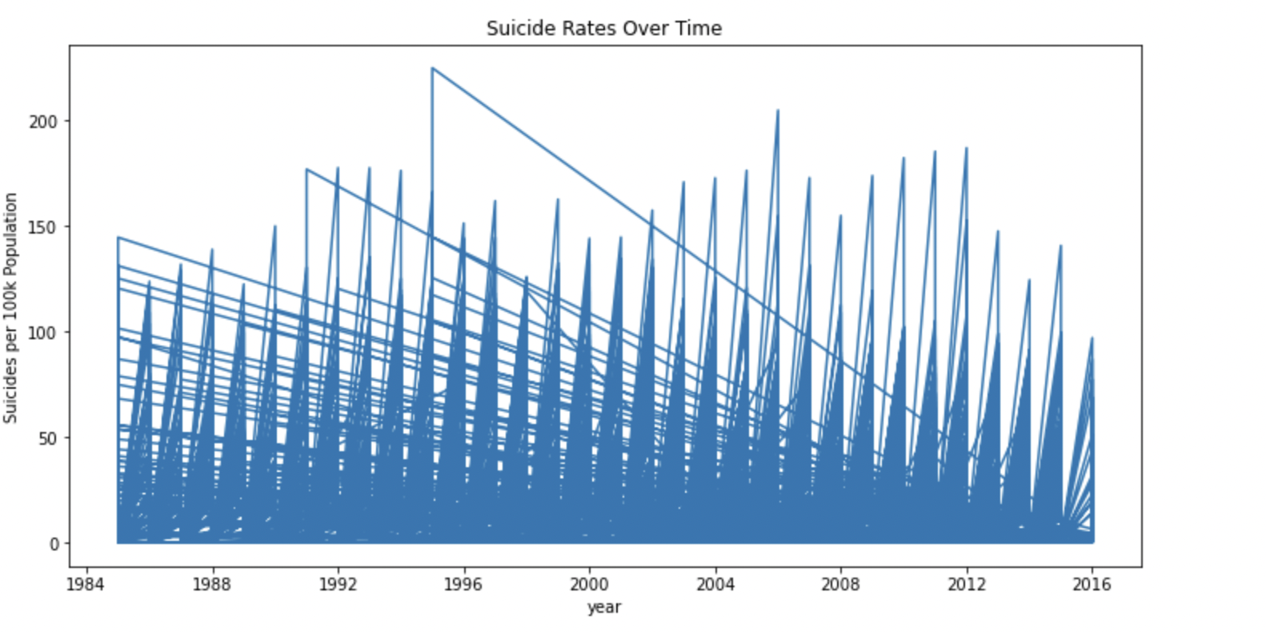
TIME SERIES ANALYSIS

Slide 12
CONCLUSION
Males consistently have a threefold higher suicide rate than females.
Suicide rates increase with age. Generational trends show the G.I. generation facing higher rates pre-2000, while Generation X and Millennials see incremental rises post-independence.
Top suicide rate countries, post-Soviet Union disintegration, suggest complex socio-economic influences. GDP per capita alone doesn't explain rates.
The global suicide rate is intricately linked to national GDP per capita, age dynamics—particularly the higher rates among the elderly—and societal pressures, emphasizing the need for holistic approaches to reduce rates and build a healthier, more supportive world.
Addressing economic challenges, supporting the elderly, and tackling societal pressures are crucial. The goal extends beyond rate reduction to building a resilient and compassionate society.

Slide 13
REFERENCES
https://www.cdc.gov/suicide/suicide-data-statistics.html
https://catalog.data.gov/dataset?tags=suicide
https://www.researchgate.net/publication/20917681_Time-series_analyses_of_the_American_suicide_rate
https://www.cdc.gov/surveillance/blogs-stories/Suicide-Trends.html
https://data.oecd.org/healthstat/suicide-rates.htm
https://www.kaggle.com/code/dornani/a-classification-analysis-on-suicide-data
https://medium.com/analytics-vidhya/exploratory-data-analysis-eda-in-python-on-suicide-rates-33da65855add

Slide 14
ACKNOWLEDGEMENT
Prof. Lindi Liao, PhD
George Mason University Department of Data Analytics Engineering
George Mason University Research Library
Neelima palleboina – G01398688
Krishna Reddy – G01398102

